Slide 1
SlicerRT Image-guided radiation therapy research toolkit for 3D Slicer
Csaba Pinter¹, Andras Lasso¹, An Wang², David Jaffray², and Gabor Fichtinger¹
¹Laboratory for Percutaneous Surgery, Queen’s University, Canada ²University Health Network, Toronto, ON, Canada

Slide 2
SparKit project overview
Goal: provide open-source platform for translational clinical research, mainly cancer
Themes:
SlicerRT: radiotherapy toolkit for 3D Slicer
SlicerIGT: Image-guided therapy with 3D Slicer
Funding by Cancer Care Ontario till 2016
PI & co-PIs: Gabor Fichtinger (Queen’s), David Jaffray (Toronto UHN), Terry Peters (Robarts)
Notes:
Runs under the umbrella project SparKit: Software Platform and Adaptive Radiotherapy Kit
Originally funded by OCAIRO, didn’t cover platform development.

Slide 3
Motivation behind SlicerRT
Commercial treatment planning systems (TPS)
Existing research tools CERR, PLUNC, dicompyler, etc.
Inconvenient
Limited feature set
Expensive
Closed
Insufficient user and developer support
Cover only routine clinical procedures
Open-source?
Well documented
Free
Poor documentation
Not extensible
User-friendly
Extensible
Large, non-modular code base
Not flexible
Flexible
Stable
Unstable
Open-source
Platform-independent
SlicerRT
Notes:
Lack of a comprehensive and open radiation therapy toolkit
RT researchers use commercial TPSs along with existing research tools. Both categories have serious shortcomings when being used for research purposes.
SlicerRT aspires to overcome these limitations, and also congregate their strong properties, such as ease of use, stability, flexibility, and so on.

Slide 4
Development principles
Leverage existing tools and parallel efforts: 3D Slicer¹, Plastimatch²
“Hub” for RT data analysis and comparison
Cover most common RT research workflows
Free, open-source license (BSD)
Open to integrate algorithms
Extensive documentation
XiO®
Pinnacle³
Eclipse™
DICOM-RT
DICOM-RT
DICOM-RT
SlicerRT
MATLAB
DICOM-RT
¹ S. Pieper, M. Halle, and R. Kikinis, 3D SLICER. Proceedings of the 1st IEEE International Symposium on Biomedical Imaging: From Nano to Macro (Brigham and Women’s Hospital, Boston, MA, 2004), pp. 632–635.
² G. C. Sharp, R. Li, J. Wolfgang, G. Chen, M. Peroni, M. F. Spadea, S. Mori, J. Zhang, J. Shackleford, and N. Kandasamy, “Plastimatch: An open source software suite for radiotherapy image processing,” in Proceedings of the XVIth International Conference on the Use of Computers in Radiotherapy (ICCR) (Amsterdam, the Netherlands, 2010).
Notes:
Approach is to leverage… By doing so, we can minimize parallel developments of for example visualization or registration tools, that are otherwise crucial parts of an RT research toolkit.
We aim SlicerRT to be a hub for…The hub approach is illustrated on the right side. It shows that SlicerRT cooperates with multiple treatment planning systems and Matlab, using their native formats.

Slide 5
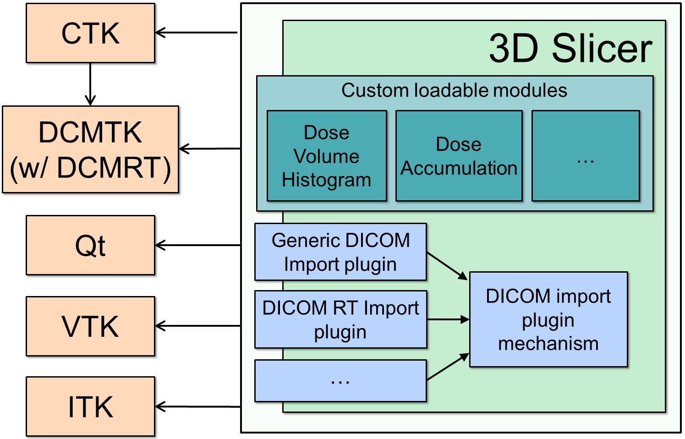
SlicerRT architecture

Slide 6
General workflow overview
3D Slicer
RT import (DICOM)
Visualization (volumes, models, 2D/3D, etc.)
Processing (registration, segmentation, etc.)
Analysis (error metrics, measurements, image fusion, etc.)
RT-specific analysis (dose comparison, DVH, …)
RT export (DICOM, Matlab, …)
SlicerRT components
3D Slicer components
Notes:
This diagram explains the general workflow that SlicerRT supports.
…It is followed by the analysis of the data using both 3D Slicer and * SlicerRT tools and algorithms…

Slide 7
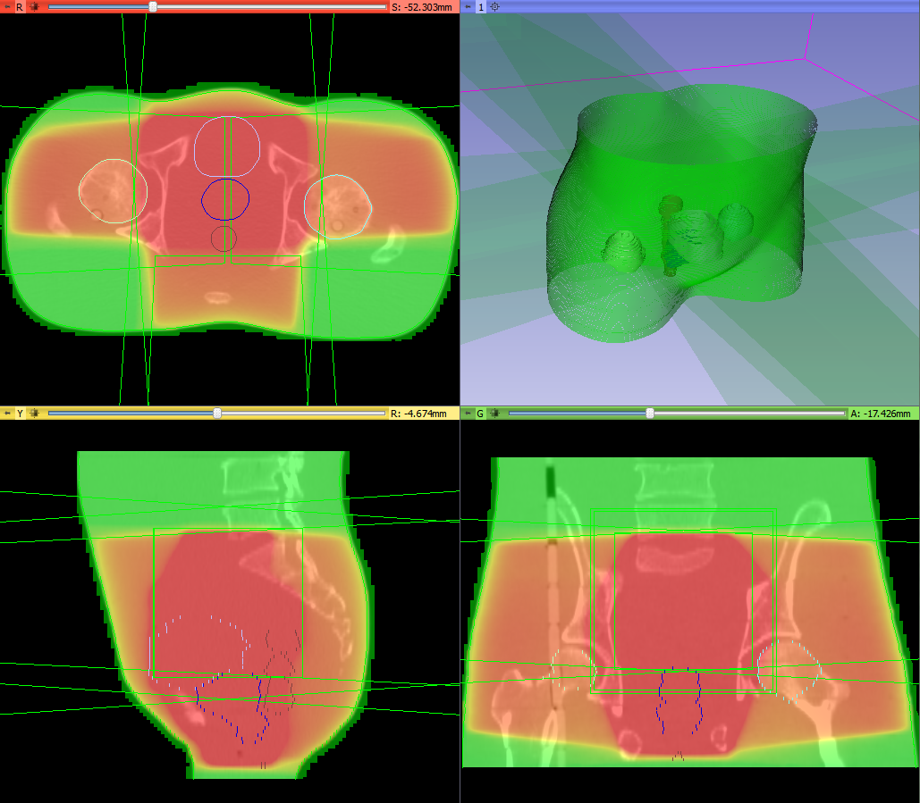
Feature group: DICOM-RT import
Integrated into core DICOM import plugin mechanism
Supported data types:
RT structure sets → Contours → Fiducial point
RT dose map
RT image
RT plan: isocenter, beams
Planning CT, MR, etc.
Standard layout after loading phantom dataset
Notes:
The first step of every RT research workflow … … seamless handling and loading of the data using only the DICOM browser in 3D Slicer

Slide 8
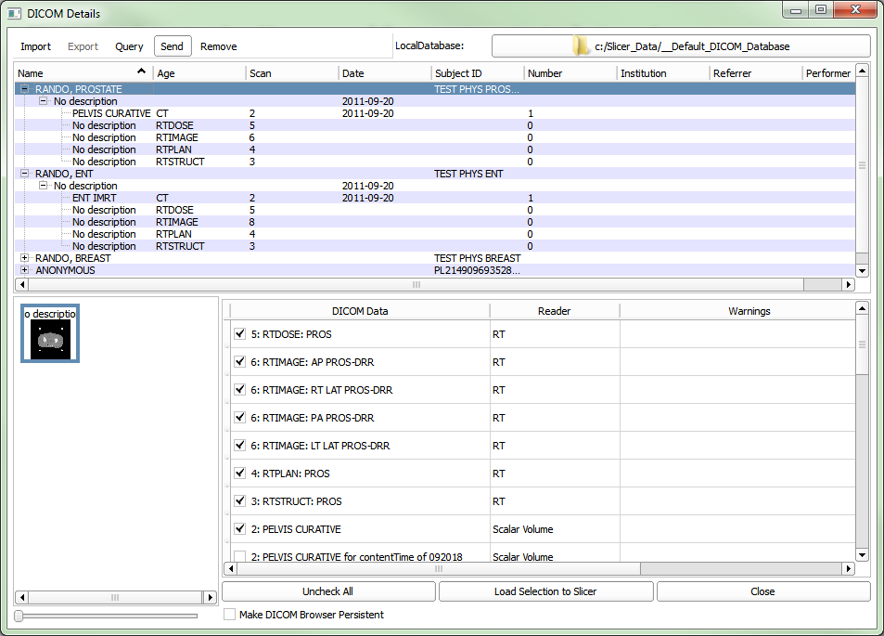
Importing DICOM-RT files
DICOM RT import plugin, integrated in the DICOM plugin mechanism
Examines files and creates “loadables”
Confidence level shows how suitable the plugin is for loading that object type
Loadables appear in the list when selecting patient/study/series
Takes charge of loading when selected and load button clicked
DICOM browser window

Slide 9
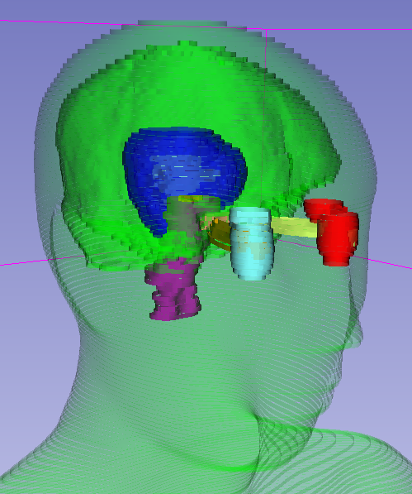
Loading RT Structure Set
Point structures → Series of points (vtkMRMLAnnotationFiducialNode objects)
Contours → Series of “ribbons,” i.e., the structure contours expanded in 3D as band surfaces (vtkMRMLModelNode objects)
The imported contours and points are organized under a hierarchy node parent
Loaded structures as ribbon models

Slide 10
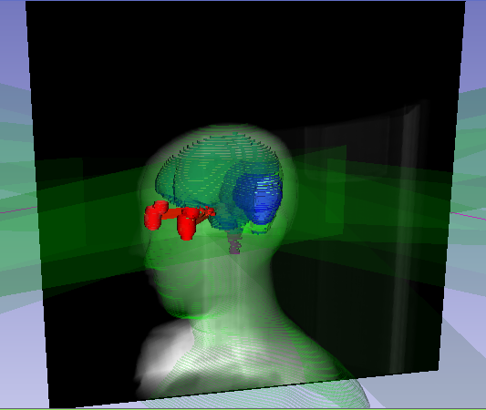

Loading RT Dose and RT Image
Dose volume → Volumetric image (vtkMRMLVolumeNode object)
Dose unit name and value stored in the hierarchy object representing the study
RT image → Planar images (vtkMRMLVolumeNode objects)
Can be displayed as geometrically aligned planes in the 3D view
Loaded dose volume
Loaded RT image
Notes:
RT Image future plans

Slide 11
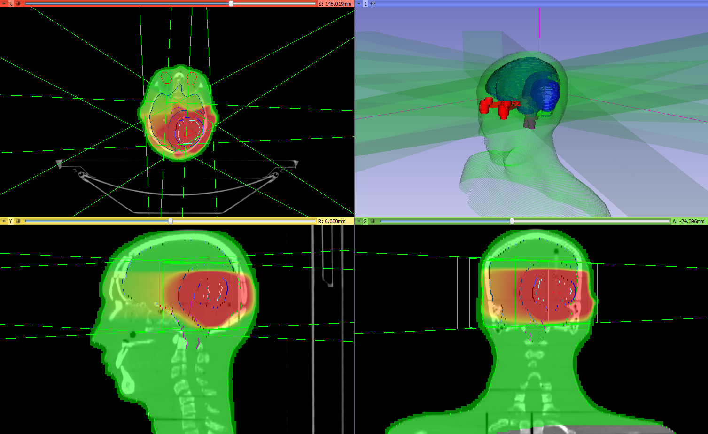
Loading RT Plan
Isocenter points → Fiducial points (vtkMRMLAnnotationFiducialNode objects)
Beam parameters → Basic beam geometries (vtkMRMLModelNode objects)
Loaded beams (along with anatomy, dose and structures)
Notes:
Future plans

Slide 12
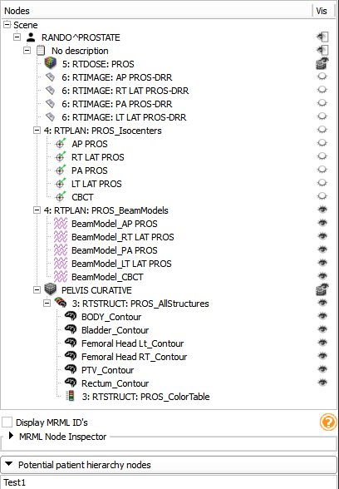
Patient Hierarchy
Maintains relationships between
Loaded objects in Slicer (e.g. dose and plan)
Loaded objects and the original DICOM files
The loaded data is organized in a Patient/Study/Series hierarchy
Utilization
DICOM-RT export
Derived objects can inherit special metadata (e.g. dose unit)
Bind RT and non-RT data together (e.g. isodose sets, color tables and dose volumes)
Transform whole studies at the same time
Set up advanced visualization automatically
Show/hide complete branches
Module UI

Slide 13
Feature group: Contour analysis
Contours module: Multiple representations (automatic conversion)
Ribbon model
Rasterized volume
Closed surface model
Contour morphology
Expand, shrink
Combine using logical operators
Contour comparison
Dice coefficient
Hausdorff distance

Slide 14
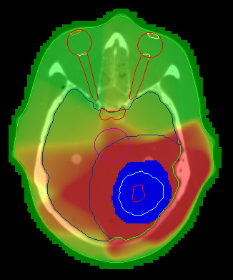
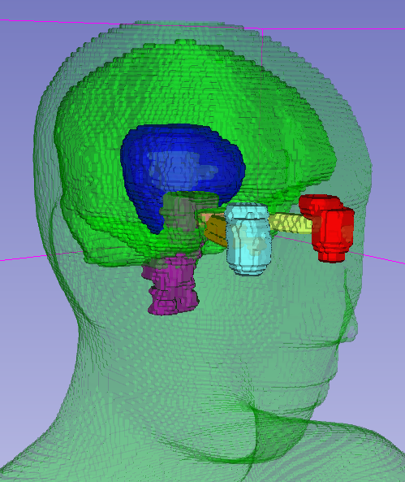
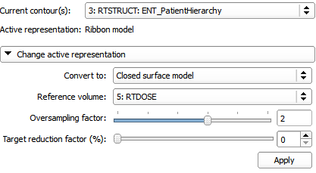
Contours module
Multiple representations (automatic conversion)
Ribbon model
Rasterized volume
Closed surface model
Ribbon model
Rasterized volume
Closed surface
Contours module UI
Notes:
Contours module allows easy handling of the imported structure set contours, by offering multiple representations and automatic conversions between those. The supported representations are…
…the desired input format for numerous processing and analysis techniques

Slide 15
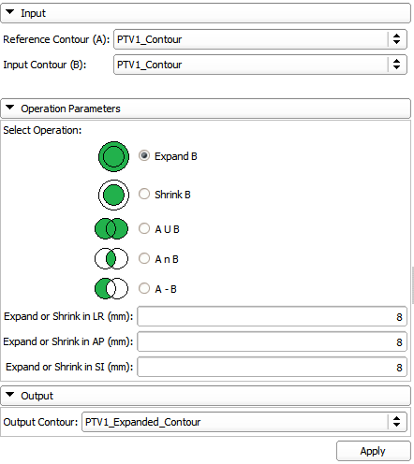
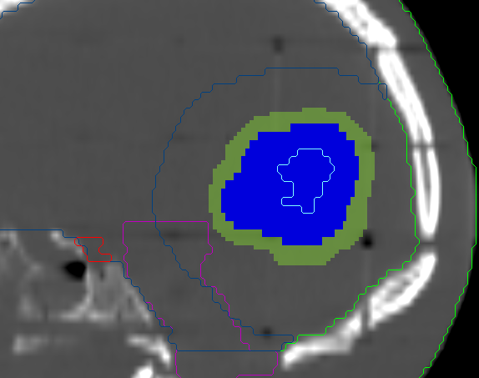
Contour Morphology module
Expand, shrink
Combine using logical operators
Target volume expanded
Contour Morphology module UI

Slide 16
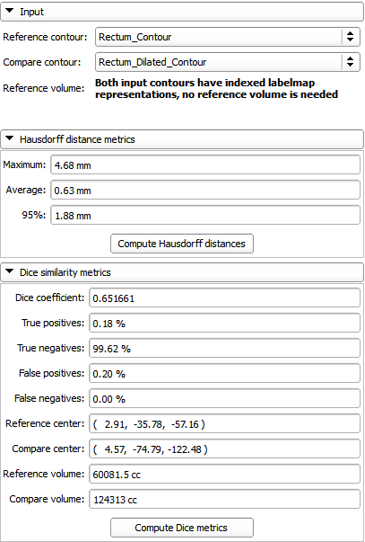
Contour Comparison module
Hausdorff distance
Dice coefficient
Contour comparison module UI

Slide 17
Feature group: Dose analysis
Dose volume histogram (plot visualization + metrics)
Dose accumulation
Dose comparison (gamma)
Isodose contours / surfaces
External beam planning – coming soon (proton, photon, electron)
Registration
BSpline registration
Landwarp registration

Slide 18
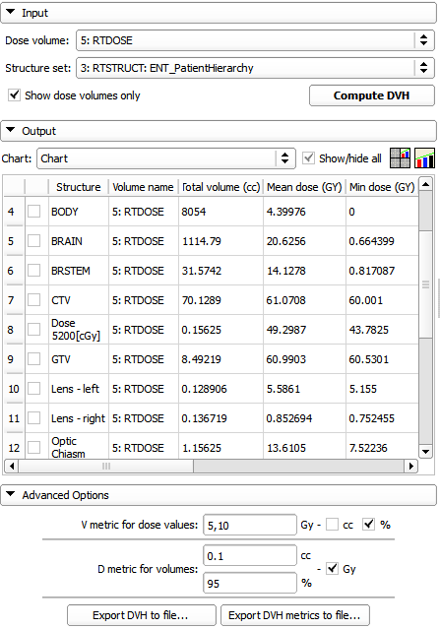
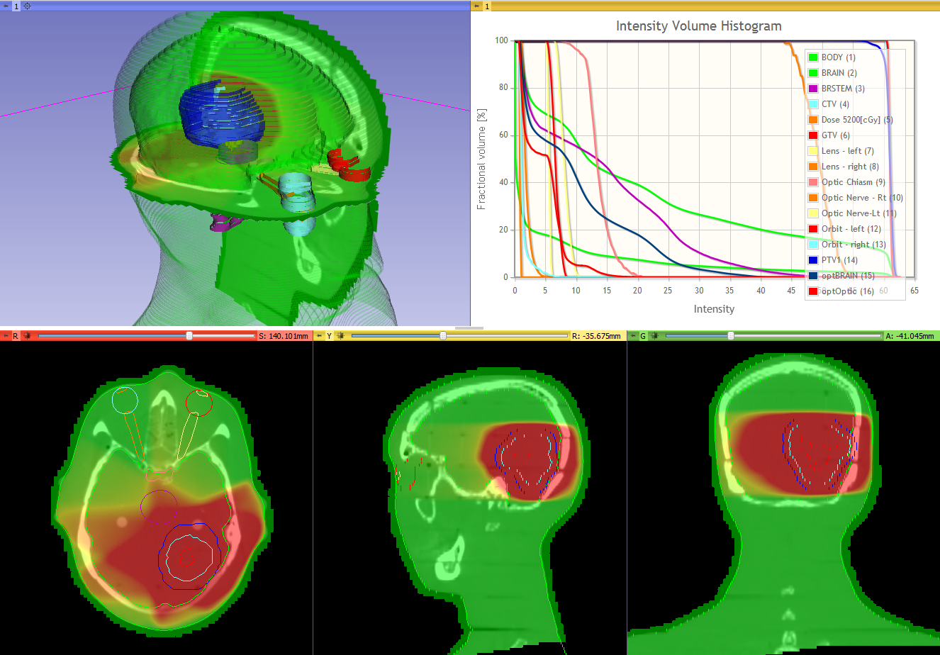
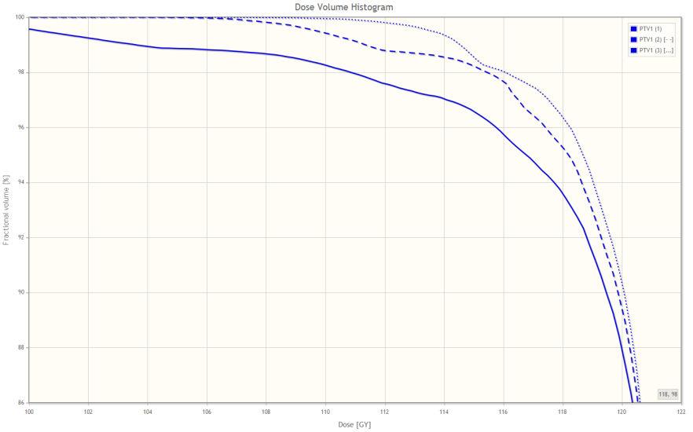
Dose Volume Histogram module
DVH with standard four-up quantitative layout
Dose Volume Histogram module UI
Compare dose volume histograms

Slide 19
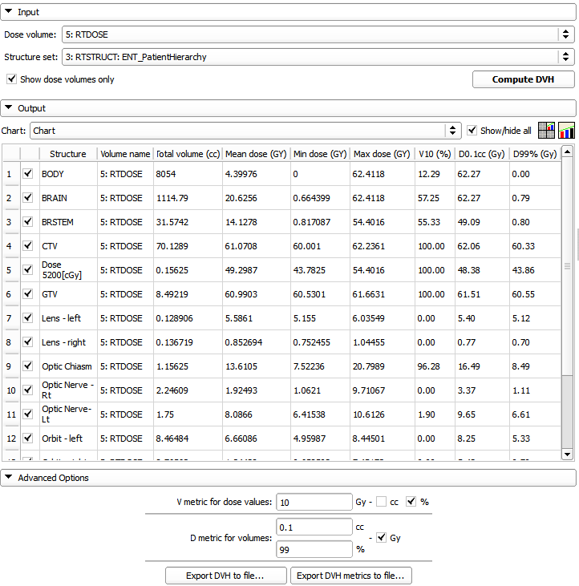
Dose metrics
Available metrics:
Total volume
Min, max, mean dose
V metrics: for user-defined levels, results in cc and %
D metrics: for user-defined levels in cc and %
Values can be exported to CSV file for further analysis.
DVH metrics in Dose Volume Histogram module

Slide 20
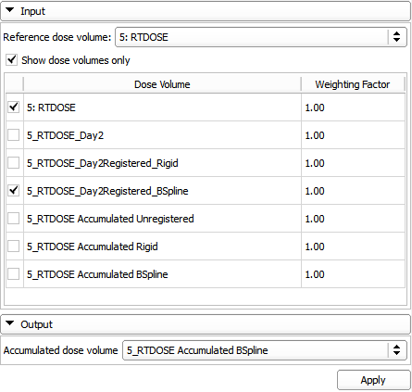
Dose Accumulation module
Dose Accumulation module UI

Slide 21
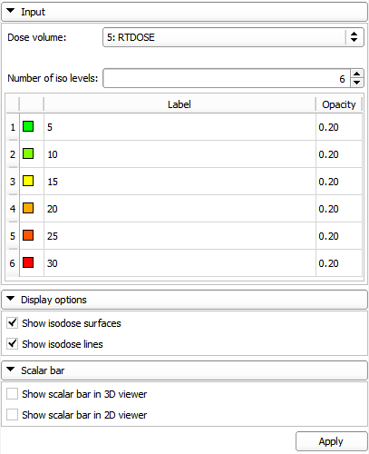
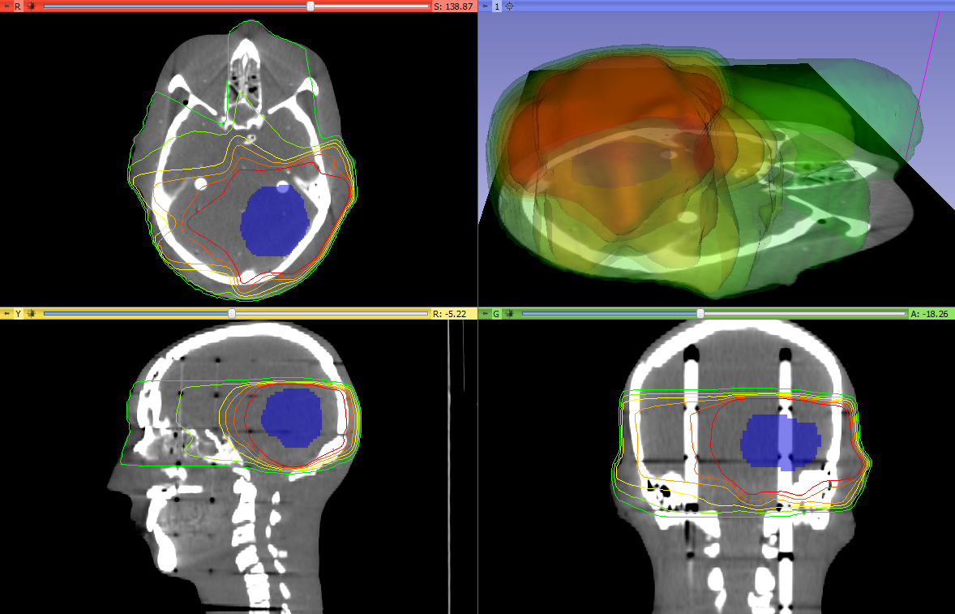
Isodose module
Computes
Isodose lines
Isodose surfaces
Isodose contours and surfaces
Isodose module UI

Slide 22
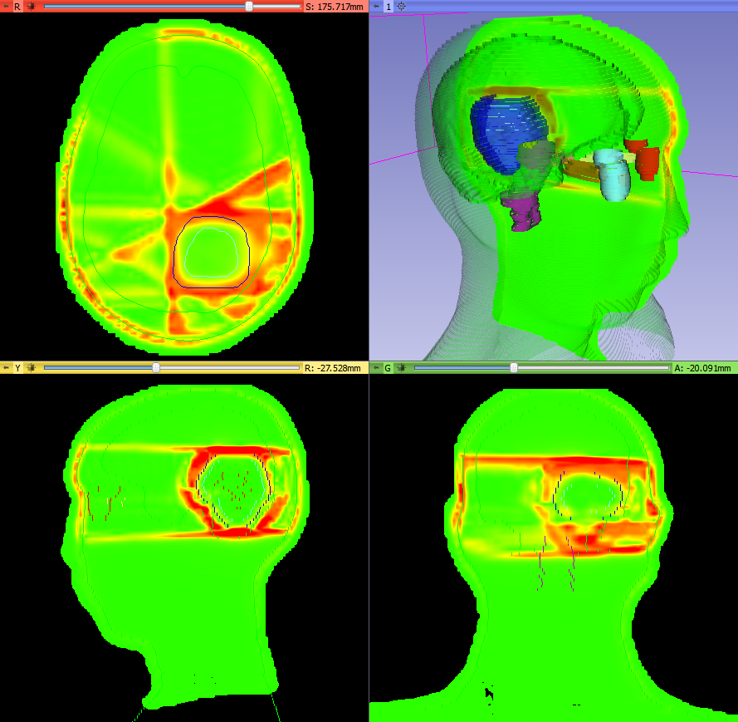
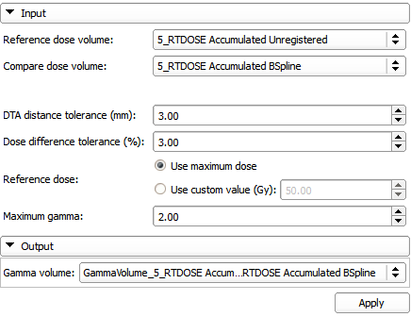
Dose comparison module
Provides gamma dose comparison
Dose Comparison module UI
Gamma volume

Slide 23
Plastimatch modules
Modules provided by the Plastimatch library
External beam planning (coming soon)
Registration
BSpline deformable registration
LANDWARP landmark deformable registration
XFORMWARP Warping with transform

Slide 24
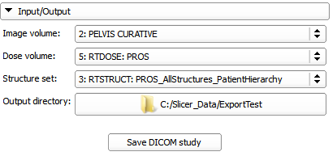
DICOM-RT export
New basic module enabling exporting simple RT studies
Supports studies containing
Anatomical volume
Dose volume
Structure set
The module will retire once the export feature is added to the Patient Hierarchy
DICOM-RT export module UI

Slide 25

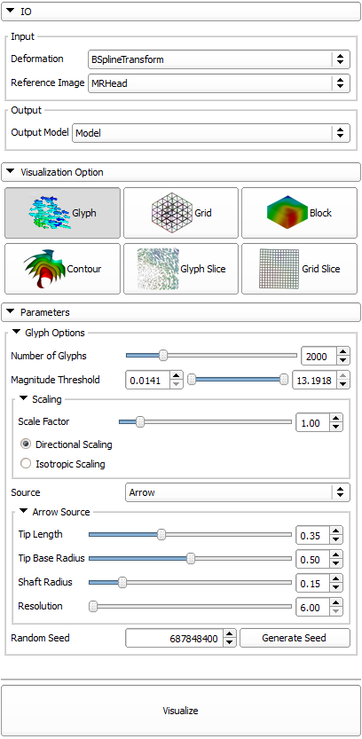
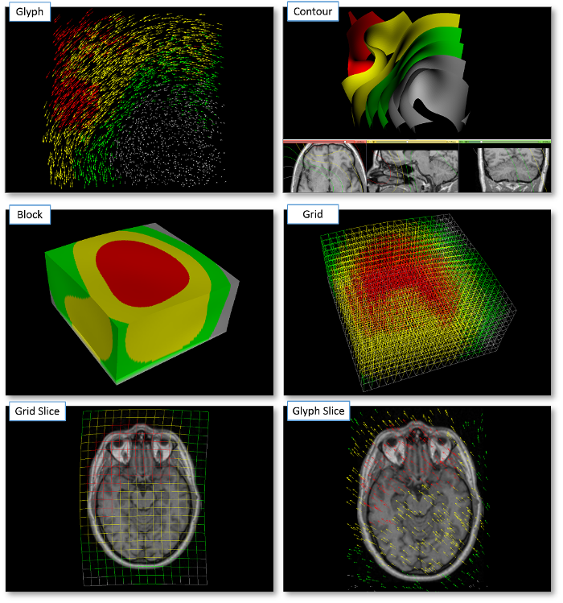
Transform visualizer
Not part of the SlicerRT extension, has to be downloaded separately from Extension Manager
Module UI
Types of transform visualizations

Slide 26

Matlab bridge
Not part of the SlicerRT extension, has to be downloaded separately from Extension Manager
Allows running Matlab functions directly in 3D Slicer
Takes input from the data loaded into Slicer and visualizes the results in Slicer right after the execution is completed
GUI is generated automatically from a standard command-line interface definition XML file (no GUI programming)
No building from source code is needed, everything can be used out of the box after downloading and installing
More information: http://www.slicer.org/slicerWiki/index.php/Documentation/Nightly/Extensions/MatlabBridge

Slide 27
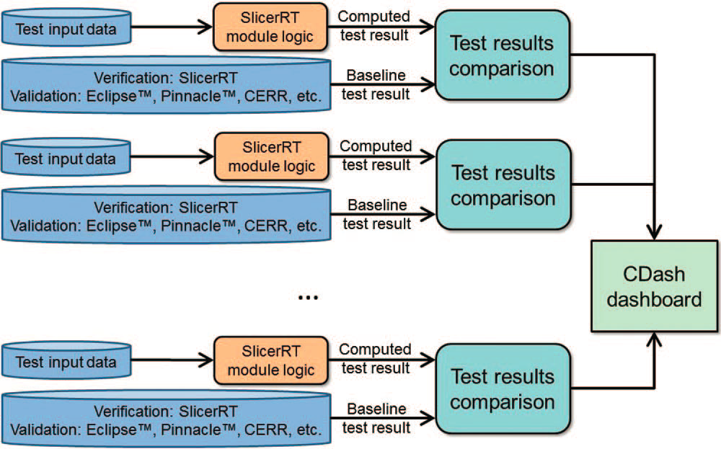
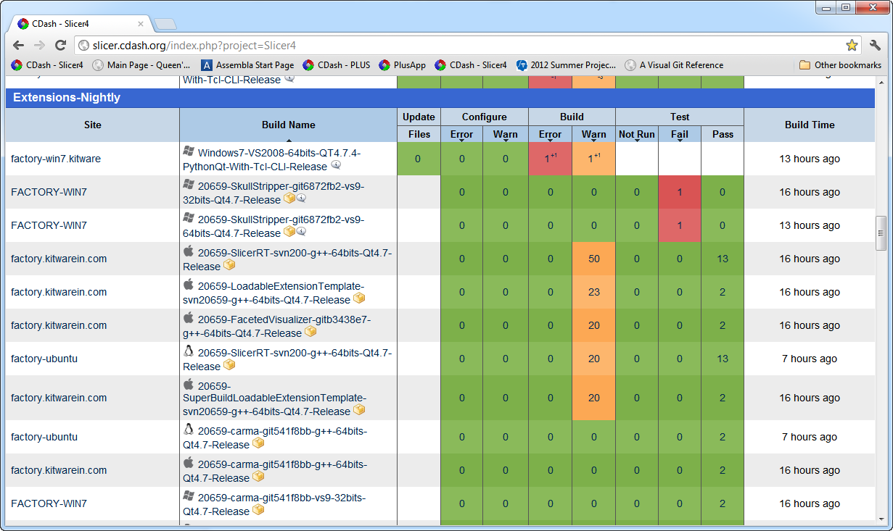
Software quality
Extensive automatic testing done on multiple platforms every night
Validated against other software packages (Pinnacle, CERR, …)
Automatic test infrastructure for automatic verification and validation
Test results reported to the web-based dashboard
http://slicer.cdash.org/index.php?project=Slicer4
Notes:
The quality of our software, which means stability, reliability, accuracy, flexibility, extensibility and maintainability is ensured by following the strict and proven development processes we adapted, and the verification and validation performed by the automated testing system. The automated unit and application tests run …
The reliability and accuracy of the SlicerRT algorithms are ensured through a series of validation tests, in course of which our results are compared to the results of other software packages, such as Pinnacle or CERR.

Slide 28
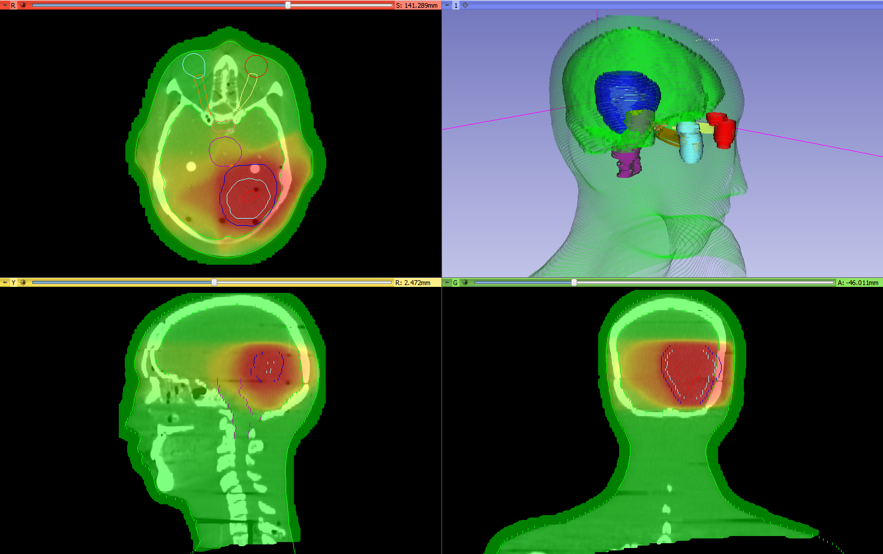
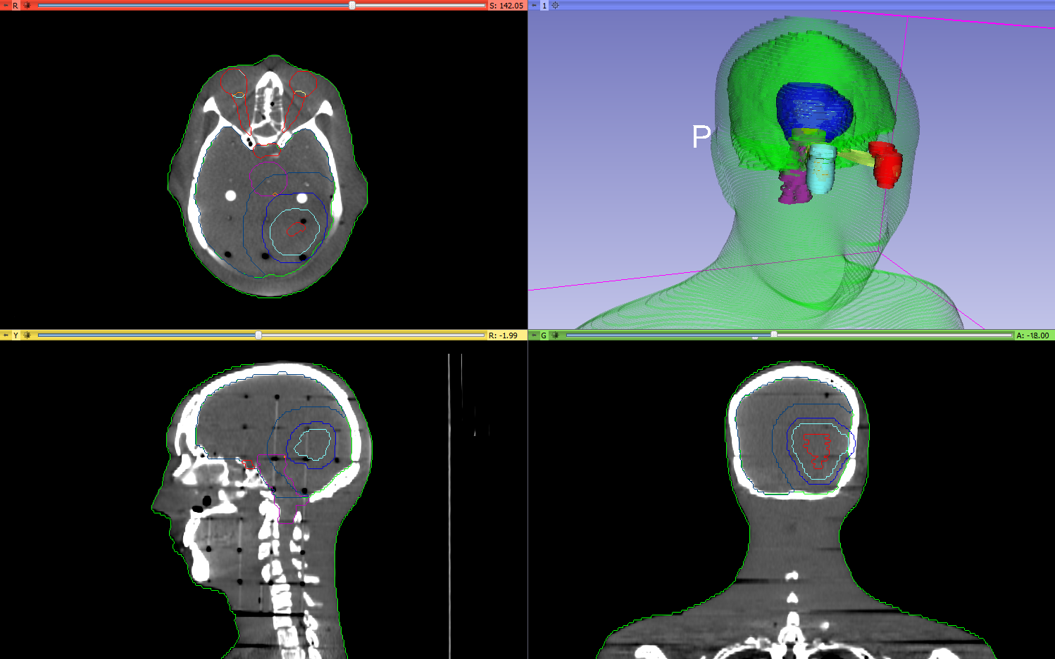
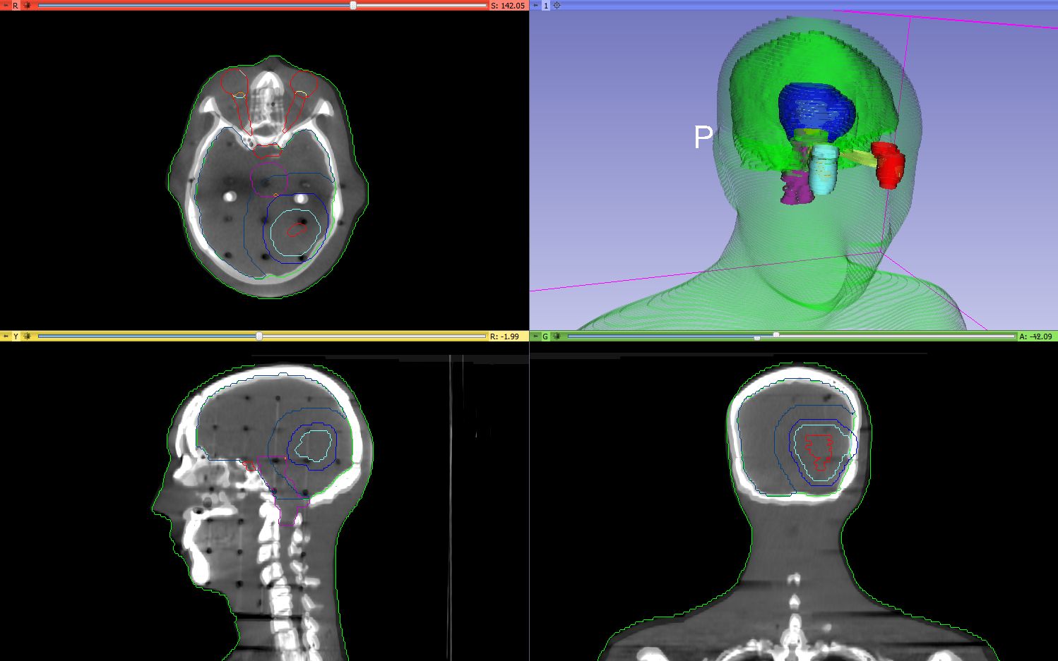
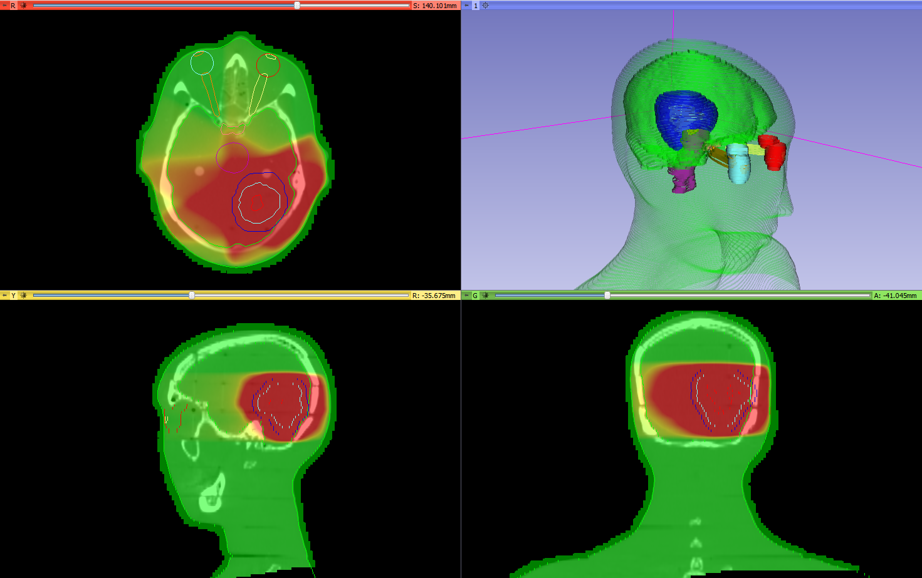
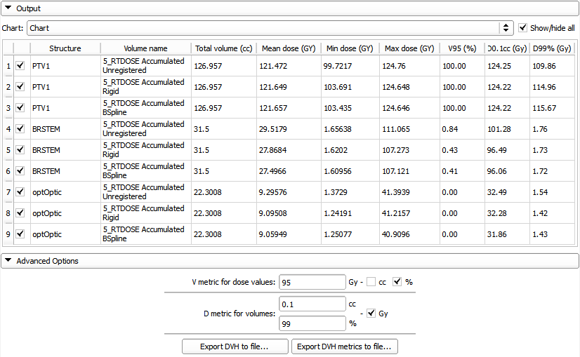
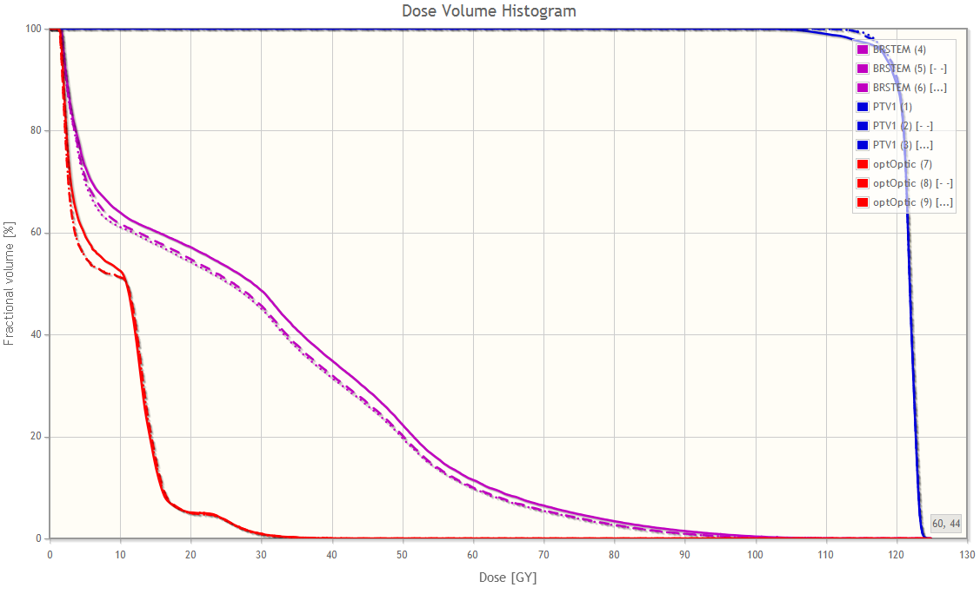
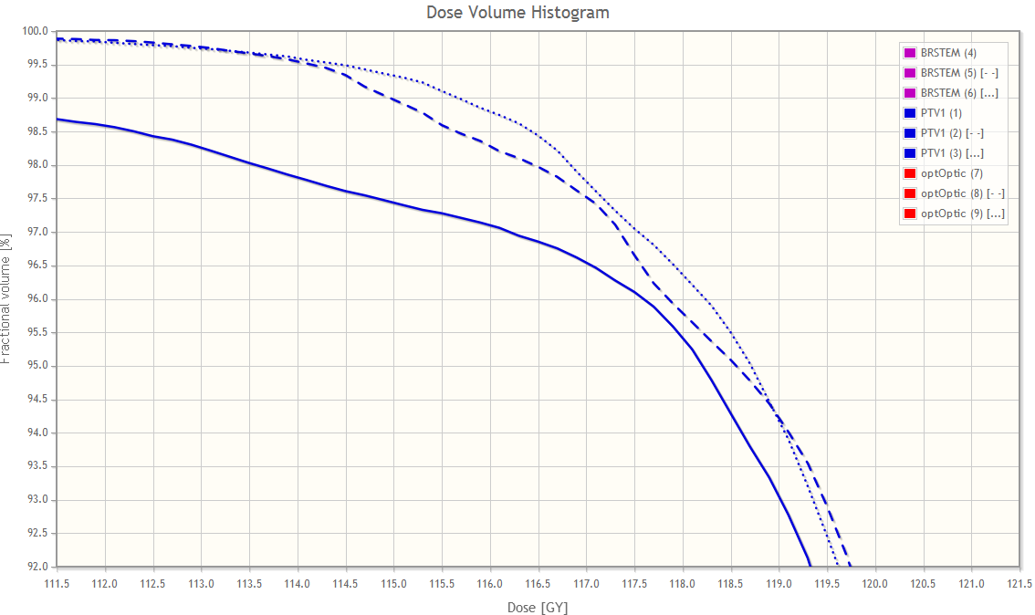
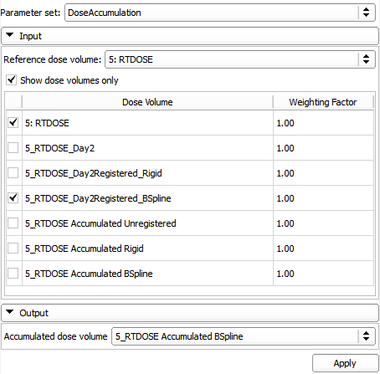
Example use case
Use case: Evaluate the effectiveness of RT plan adaptation
Import, load and visualize data
Register day 1 CT with day 2 CT
Rigid
Bspline
Resample day 2 dose using results
Accumulate doses
Compute and display DVH for all methods
Compare DVH curves and metrics for target volume and organs at risk
Notes:
…example use case, possibly the one that covers the most features available in SlicerRT at the moment. …
We compute the results without adaptation as a baseline. …
… between the two CT images. We need to register them and apply the registration result to the day two dose distribution, thus aligning the two datasets together for analysis.
Zooming in on the area the target dose starts to fall, we can compare the delivered dose better for each case.
We can also check the basic metrics and compute more complicated ones to quantify the differences.

Slide 29

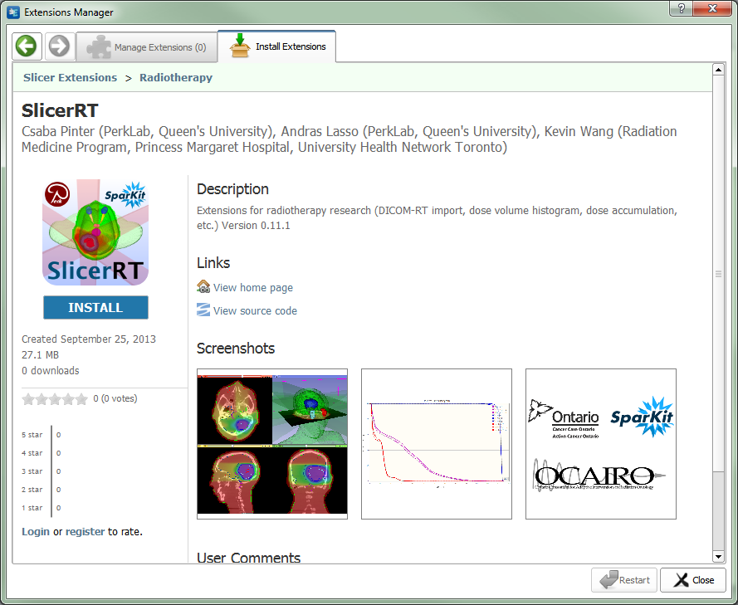
SlicerRT extension for 3D Slicer
Collection of RT-specific modules, includes
Distributed as a 3D Slicer extension: can be downloaded, installed, upgraded using the extension manager in Slicer
SlicerRT extension in the 3D Slicer app store (free)
Notes:
SlicerRT is distributed as a 3D Slicer extension. It can be easily found and installed from the Slicer AppStore.

Slide 30
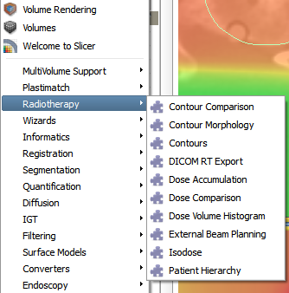
Next steps
Enhancements planned for the next 6 months:
DICOM-RT export
Integrating Contours and Subject Hierarchy into 3D Slicer core
Digitally reconstructed radiograph
Rasterization improvements
Support CERR PlanC format
Scripting examples
More testing and validation
Current radiotherapy modules (including work-in-progress modules)
Detailed plan: https://www.assembla.com/spaces/slicerrt/tickets
Notes:
Suggestions, comments and feature requests are warmly welcome! Our weekly meetings on every Monday are also open to anybody to discuss any matter related to the toolkit.

Slide 31



Thank you!
Overview paper: Csaba Pinter, Andras Lasso, An Wang, David Jaffray, and Gabor Fichtinger, “SlicerRT: Radiation therapy research toolkit for 3D Slicer”, Med. Phys. 39 (10), October 2012
Project homepage: http://www.SlicerRT.org/
Contact: Csaba Pinter (csaba.pinter@queensu.ca)

